Slide 1
All About Scratch
By Rishivandhan Musuvathi

Slide 2
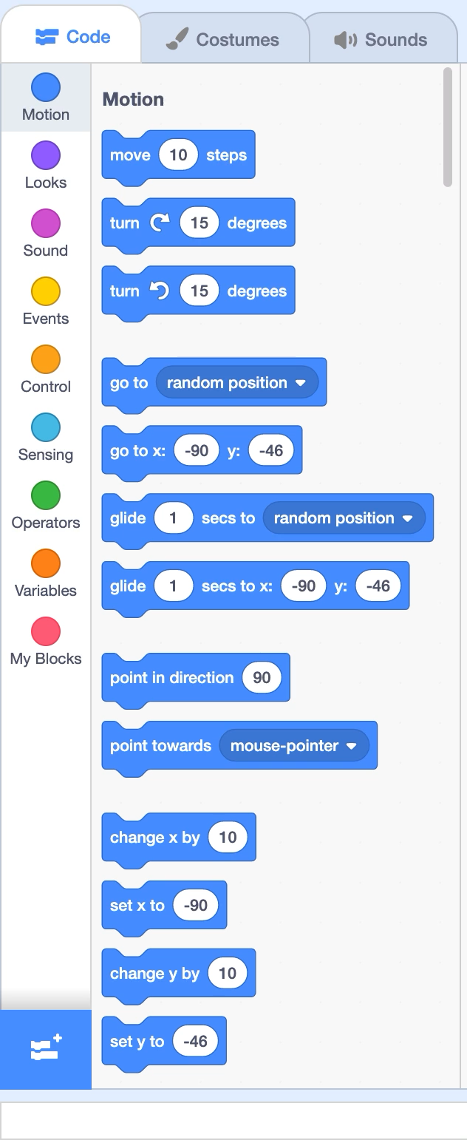
What is Block Coding
Block coding is the first step into learning programing games and more
They are generally used to create games and apps.
There are multiple platforms where you can do block coding.
The picture on the right shows couple of blocks used in scratch.
These blocks are used to make any games you wish to make using scratch.

Slide 3
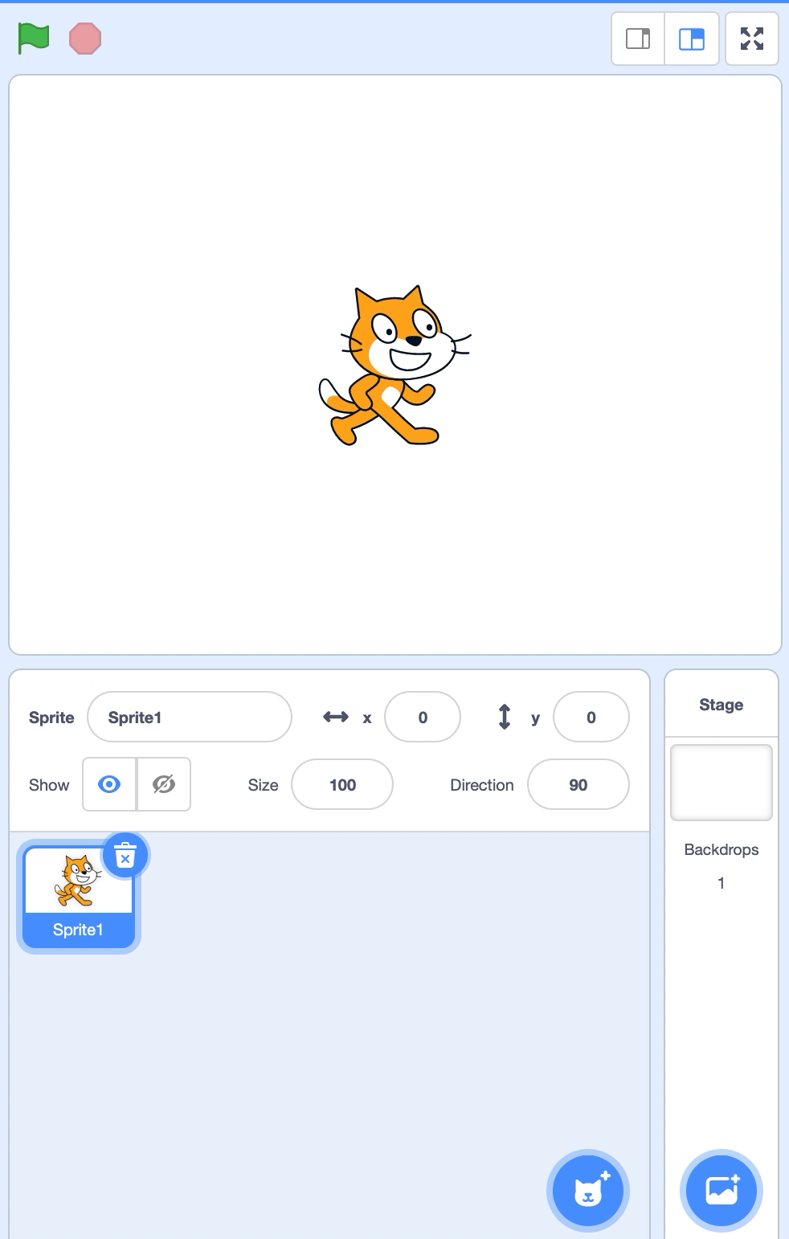
The Stage
The Stage is where all of you coded blocks perform.
Some Of the things you could do with a stage are:
control your character using your mouse in the stage.
change the name of the character
change the location of the character
change the size of the character
change the direction of the character
add more characters.
change the background.

Slide 4
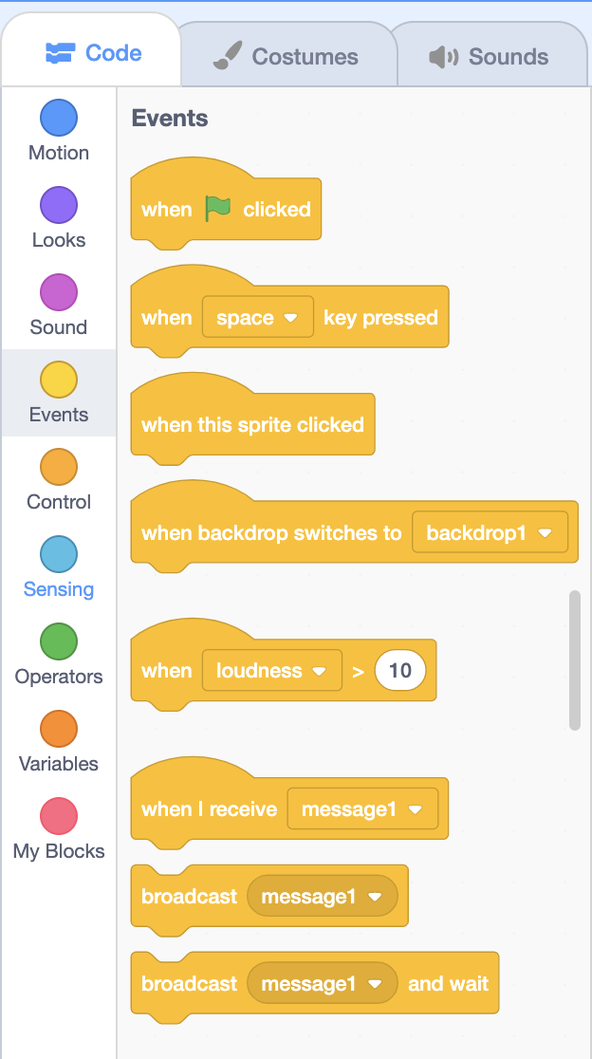
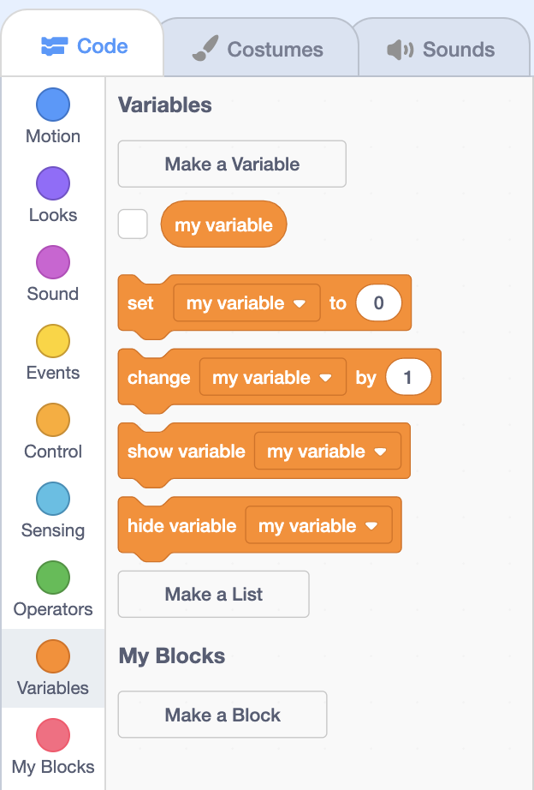
Blocks and its Function
Event Blocks
These are blocks used when you want to start your program
there is at least one event block found in every program.
Variable Blocks
Variables are block that you can make and store information in.
Many people make variables to keep track of score or keep track of a timer, etc.
They are very useful when you want to keep track of something

Slide 5
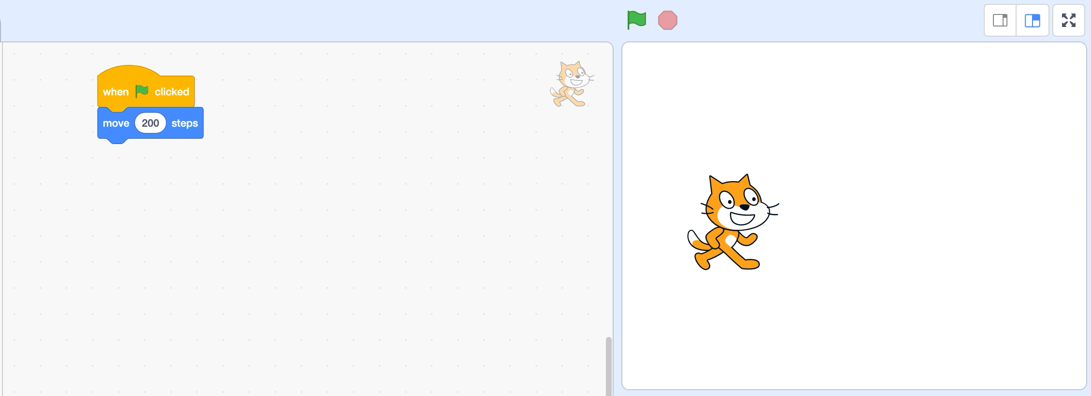
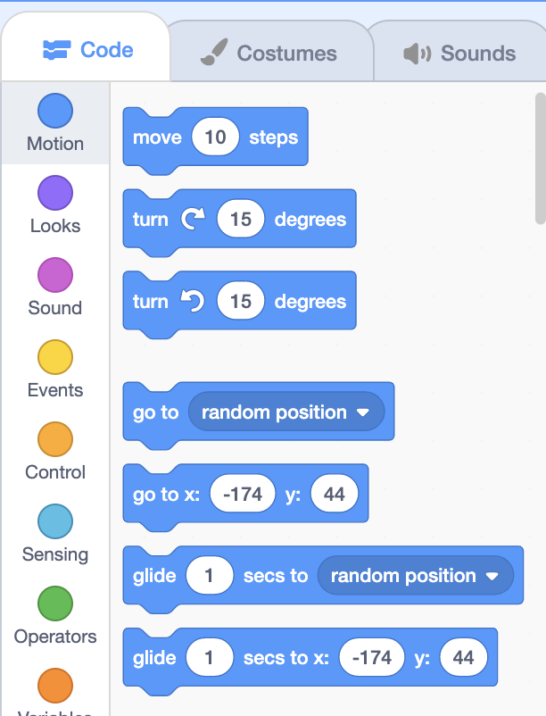
Blocks and its Function
Motion Blocks
These block change the movement of the sprite
These blocks help your character move from one spot of the stage to another spot.

Slide 6
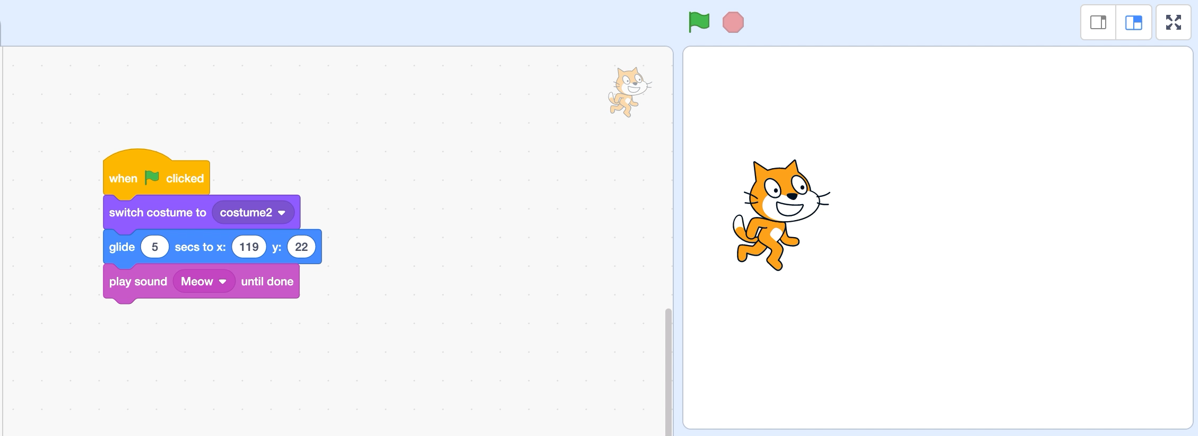
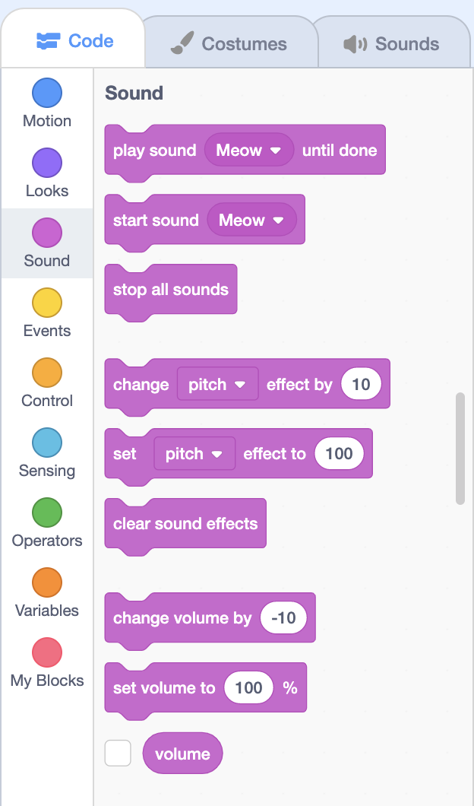
Blocks and its Function
Sound Blocks
These block gives your spirit a voice
It can play any sound you can find in the scratch data base.

Slide 7
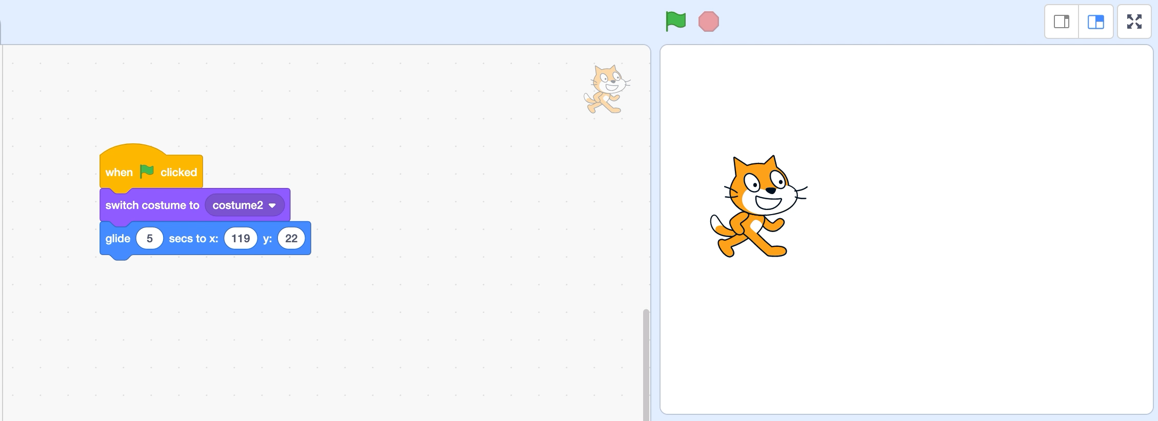
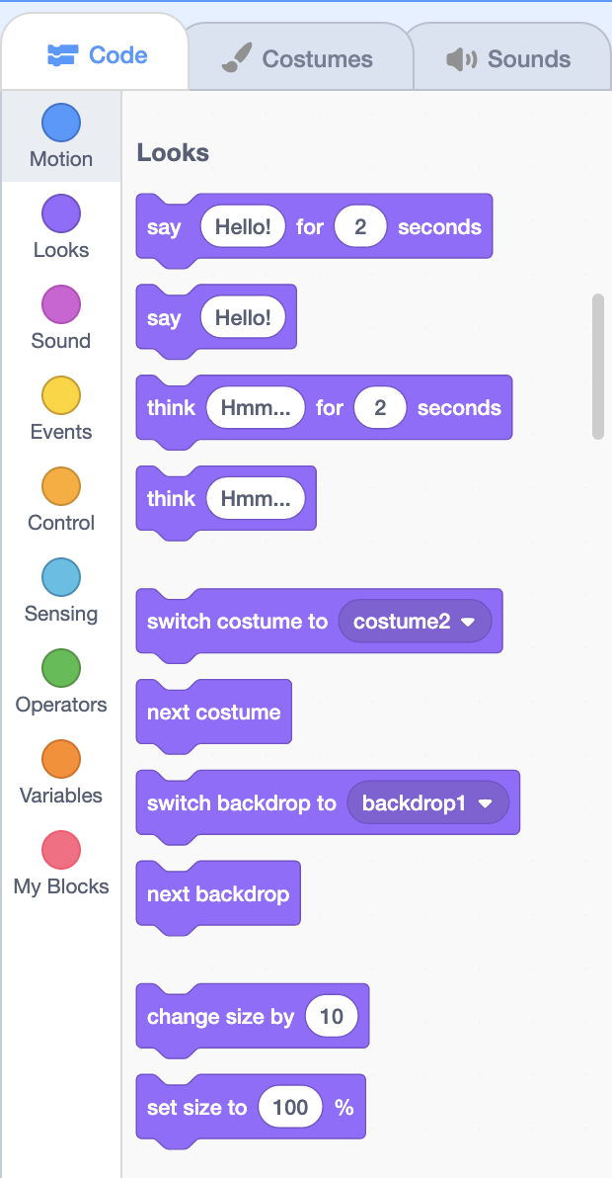
Blocks and its Function
Looks Block
These block changes the way your character (sprite) looks during your program.

Slide 8
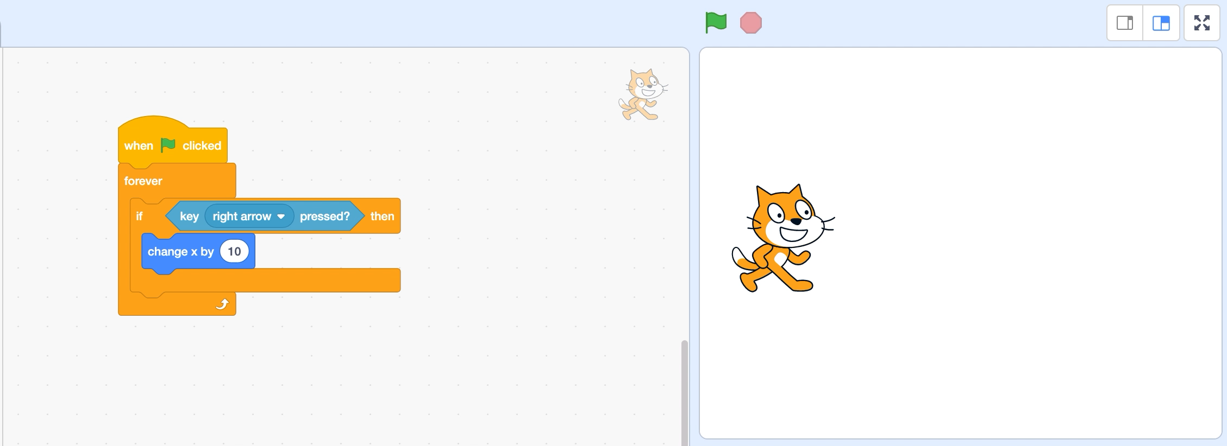
If or else Statements
If or Else statements are conditional statement
These statements can be seen in almost every coding languages
If given condition is true, then it will result in the given result

Slide 9
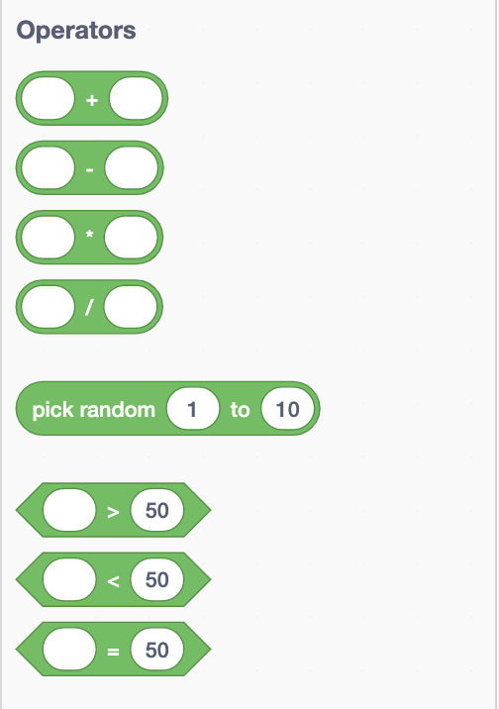
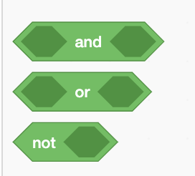
Operators
There are different types of operators in scratch and they are:
+
-
*
<
>
=
Using operators in if-else statements
There are different conditions like these shown above that can be used in if-else statements

Slide 10
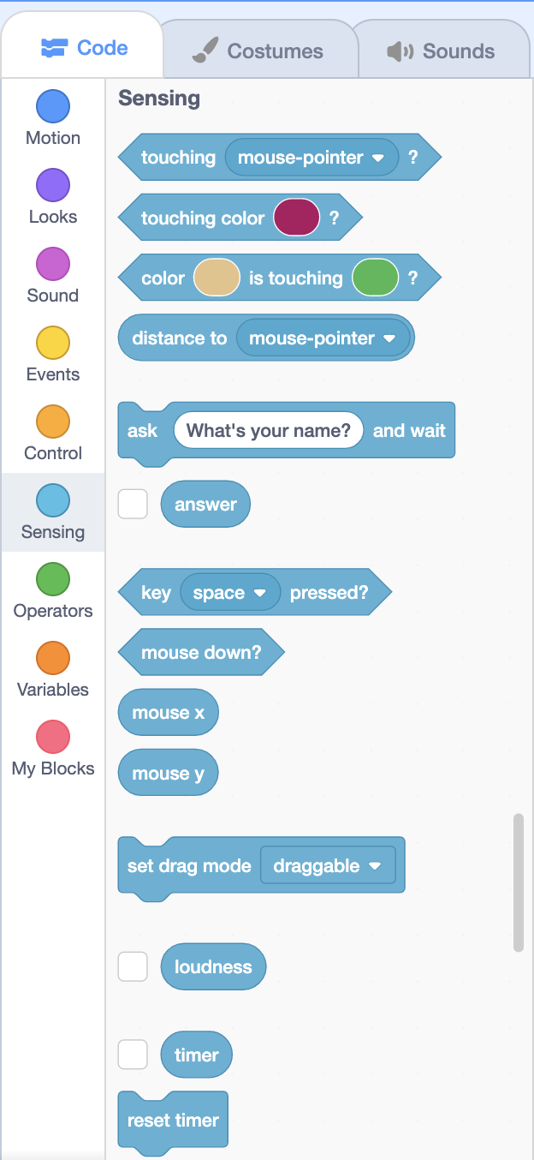
Blocks and Its Functions
Sensing
These blocks are mostly used inside other blocks.
These are called Parameters
They set a boundary or a limit to what a conditional statement can do.

Slide 11
Kahoot time!
https://create.kahoot.it/share/scratch-basics/a6db581e-85bd-4cc4-920c-04c139cd403d

